Slide 1
Oncor Reliability Projects North, North Central, Central and South Central
ERCOT RPG Meeting
01/16/2026
Montse Meadows

Slide 2
Introduction
Oncor is experiencing significant demand growth across its service territory
The 2024 ERCOT RTP (Regional Transmission Plan) included more than 14,000 MW of Substantiated Loads
Oncor’s current load interconnection queue is now substantially larger than the levels studied in the 2024 RTP
As of September 30, 2025, Oncor’s active LC&I interconnection queue included over 600 requests which is approximately 60% higher than at the same time last year.
210 GW from data centers
Over 16 GW of load from various other industrial sectors
The 2024 RTP studies identified 33 reliability projects where Oncor is the facility/transmission owner, and 3 projects where Oncor and Lone Star are the facility/transmission owners
Oncor submitted five RPG submittals to address these reliability projects based on ERCOT’s recommendation:
Projects with ERCOT-identified needs in both 2024 RTP and 2025 RTP analysis
RPG #1: Set 1 North & Central Texas Reliability Project
RPG #2: Set 1 North Central & South Central Texas Reliability Project
Projects with ERCOT-identified needs in 2024 RTP but not in 2025 RTP analysis
RPG #3: Set 2 North & Central Texas Reliability Project
RPG #4: Set 2 North Central & South Central Texas Reliability Project
RPG #5: Oncor and Lone Star's RPG Submittal Navarro and Ellis Area Reliability Project
Oncor Reliability Projects North, North Central, Central and South Central Oncor Electric Delivery Company LLC. All rights reserved.

Slide 3
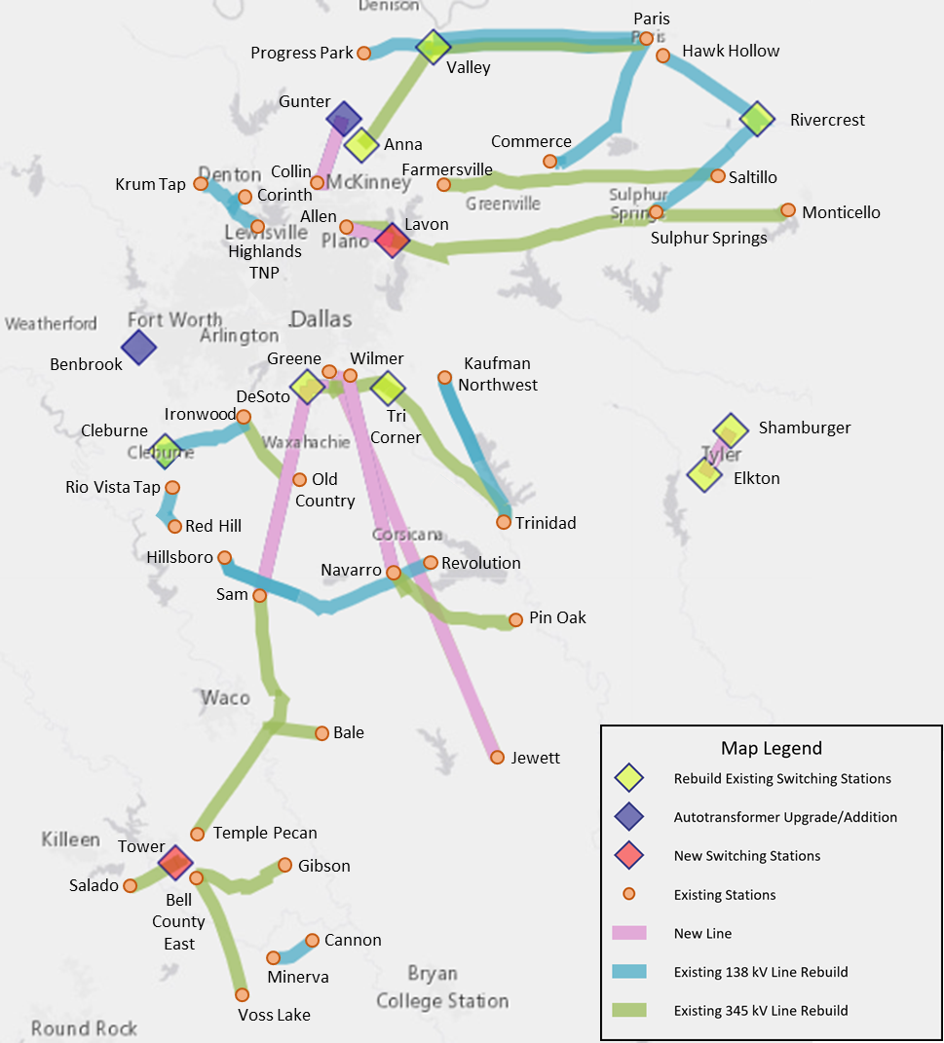
Map of Area Upgrades
Oncor Reliability Projects North, North Central, Central and South Central Oncor Electric Delivery Company LLC. All rights reserved.

Slide 4
Project Overview: Set 1 North & Central Texas Reliability Project
Tier-1 Project in Collin, Dallas, Delta, Ellis, Fannin, Franklin, Grayson, Henderson, Hill, Hopkins, Hunt, Johnson, Kaufman, Lamar and Navarro counties
CCN Required
Proposed upgrades will address thermal and voltage planning criteria violations identified by ERCOT in the 2024 RTP and 2025 RTP
Summary of Upgrades:
One new Switch Station
Lavon 345/138 kV Switch
Four Switch Station Rebuilds
Anna 345 kV Switch
Valley 345 kV Switch
Tri Corner 345 kV Switch
Cleburne 138 kV Switch
Two new 138 kV lines (29.1 circuit-miles)
12.7-mile Lavon Switch – Allen Switch 138 kV Line
16.4-mile Gunter Switch – Collin Switch 138 kV Line on the existing double-circuit capable structure
415.1 circuit-miles upgrade of 345 kV and 138 kV lines
330.7 circuit-miles of 345 kV line
84.4 circuit miles of 138 kV line
Cost Estimate: $1.798 billion
Oncor Reliability Projects North, North Central, Central and South Central Oncor Electric Delivery Company LLC. All rights reserved.

Slide 5
Project Overview: Set 1 North Central & South Central Texas Reliability Project
Tier-1 Project in Bell, Falls, Henderson, Hill, Limestone, McLennan, Milam, and Navarro counties
CCN Required
Proposed upgrades will address thermal and voltage planning criteria violations identified by ERCOT in the 2024 RTP and 2025 RTP
Summary of Upgrades:
One new Switch Station
Tower 345 kV Switch
Three new 345 kV lines (27.2 circuit-miles)
1.2 circuit-mile Tower Switch – Knob Creek Switch 345 kV Line
1.2 circuit-mile Tower Switch – Knob Creek Switch 345 kV Line
12.4-mile Salado Switch – Tower Switch 345 kV Double-Circuit Line on existing ROW
245.6 circuit-miles upgrade of 345 kV and 138 kV lines
193.1 circuit-miles of 345 kV line
52.5 circuit-miles of 138 kV line
Cost Estimate: $943.92 Million
Oncor Reliability Projects North, North Central, Central and South Central Oncor Electric Delivery Company LLC. All rights reserved.

Slide 6
Project Overview: Set 2 North & Central Texas Reliability Project
Tier-1 Project in Collin, Dallas, Denton, Delta, Ellis, Fannin, Freestone, Henderson, Hopkins, Hunt, Kaufman, Lamar, Leon, Navarro, Tarrant and Red River counties
CCN Required
Proposed upgrades will address thermal and voltage planning criteria violations identified by ERCOT in the 2024 RTP
Summary of Upgrades:
Three Switch Station Rebuild
DeSoto 345/138 kV Switch
Argyle 138 kV Switch
Rivercrest 138 kV Switch
Two new 345 kV lines (231 circuit-miles)
112.5-mile Jewett Switch – Greene Switch 345 kV Double-Circuit Line
3.0-mile Greene Switch – Wilmer Switch 345 kV Double-Circuit Line
One new 138 kV line (3.82 circuit-miles)
DeSoto Switch – Loop Nine Switch 138 kV Line
239.9 circuit-miles upgrade of 345 kV and 138 kV lines
84.9 circuit-miles of 345 kV line
155 circuit-miles of 138 kV line
Autotransformer
Install Gunter 345/138 kV Autotransformer #2
Upgrade Benbrook 345/138 kV Autotransformer #1
Cost Estimate: $1.330 Billion
Oncor Reliability Projects North, North Central, Central and South Central Oncor Electric Delivery Company LLC. All rights reserved.

Slide 7
Project Overview: Set 2 North Central & South Central Texas Reliability Project
Tier-1 Project in Hill, McLennan, Navarro and Smith counties
CCN Required
Proposed upgrades will address thermal and voltage planning criteria violations identified by ERCOT in the 2024 RTP
Summary of Upgrades:
Two Switch Station Rebuild
Elkton 345/138 kV Switch
Shamburger 345/138 kV Switch
One new 345 kV line (27.6 circuit-miles)
13.8-mile Elkton Switch - Shamburger Switch 345 kV Double-Circuit Line
75.8 circuit-miles upgrade of 345 kV and 138 kV lines
51.4 circuit-miles of 345 kV line
24.4 circuit miles of 138 kV line
Cost Estimate: $440.79 million
Oncor Reliability Projects North, North Central, Central and South Central Oncor Electric Delivery Company LLC. All rights reserved.

Slide 8
Project Overview: Oncor and Lone Star's RPG Submittal Navarro and Ellis Area Reliability Project
Tier-1 Project in Dallas, Ellis, Freestone, Hill and Navarro counties
CCN Required
Proposed upgrades will address thermal and voltage planning criteria violations identified by ERCOT in the 2024 RTP
Summary of Upgrades:
Two new 345 kV lines (218 circuit-miles)
53.0-mile Wilmer Switch – Navarro Switch (Lonestar) 345 kV Double-Circuit Line
56.0-mile Desoto Switch – Sam Switch (Lonestar) 345 kV Double-Circuit Line
61.6 circuit-mile upgrade of 345 kV lines
Cost Estimate: $759.95 million
Oncor Reliability Projects North, North Central, Central and South Central Oncor Electric Delivery Company LLC. All rights reserved.

Slide 9
Questions?
Oncor Reliability Projects North, North Central, Central and South Central Oncor Electric Delivery Company LLC. All rights reserved.

